Slide 1
Building Multi-Tenant Applications

Slide 2
Agenda
Who am I
What is multi-tenancy
How to detect a tenant
Demo time!

Slide 3
Who am I?

Slide 4
Ruben
Started on KdG
8 Jaar dotnet
Full stack developer
Architect
Trainingen
Sessies
Internship
….
🥁 🎸 🎹
🎲 🐉

Slide 5
What is multi tenancy?

Slide 6
What is it?
Running your software for multiple clients (aka tenants) at once

Slide 7
Not all Multi-tenancy is equal
What do you think is possible?

Slide 8
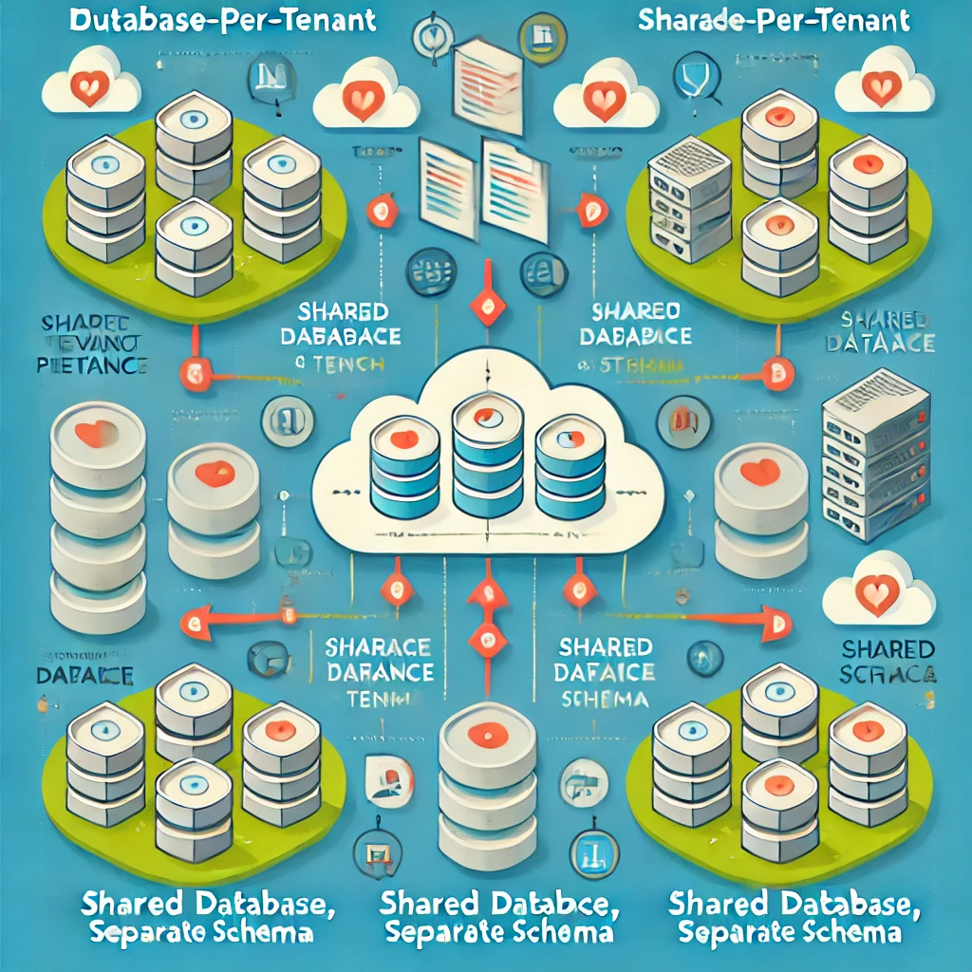

Slide 9
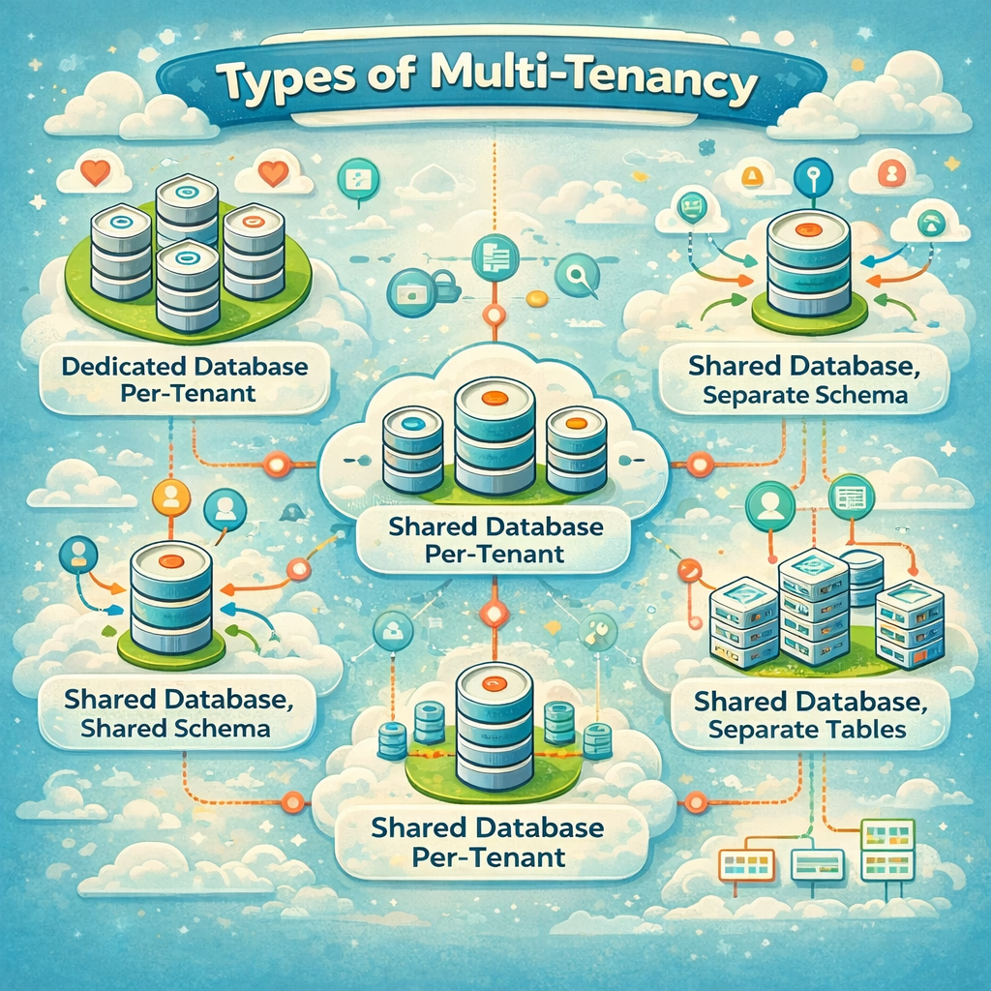

Slide 10
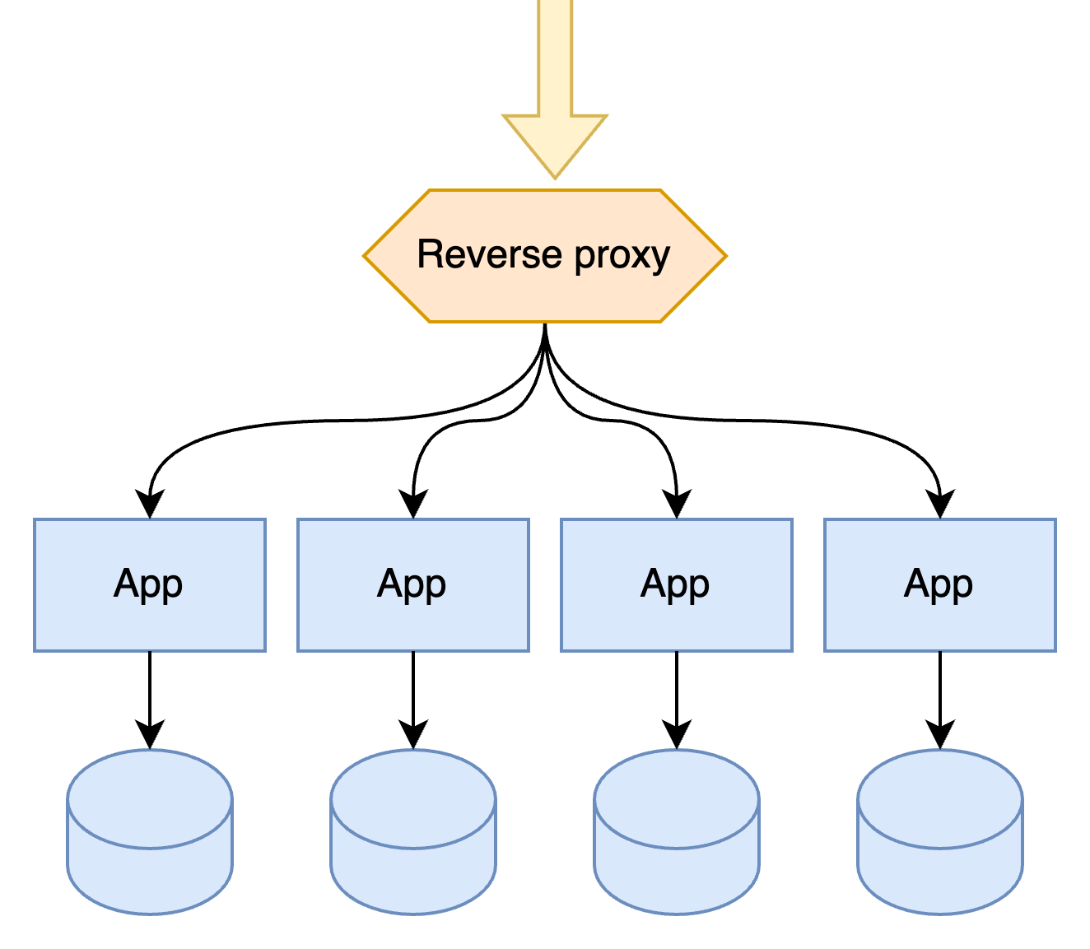

Slide 11
Multi-tenancy by infrastructure
✅ App has no knowledge of tenants
✅ Data is perfectly separated
❌ Cross-cutting concerns are harder
❌ High cost of operation
❌ Cross tenant reporting

Slide 12
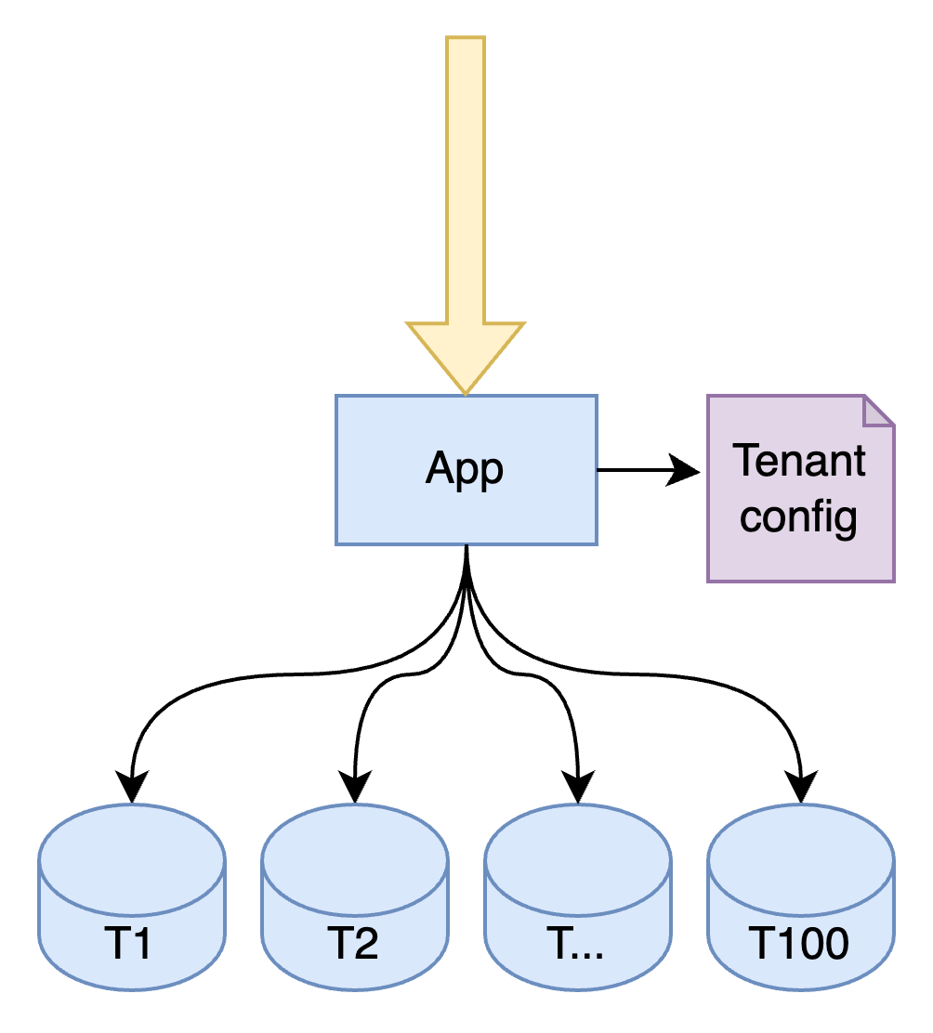

Slide 13
Database per tenant
✅ Data is perfectly separated
💭 App needs config per tenant
❌ (still) high cost of operation
❌ Data consistency between tenants
❌ Cross tenant reporting

Slide 14
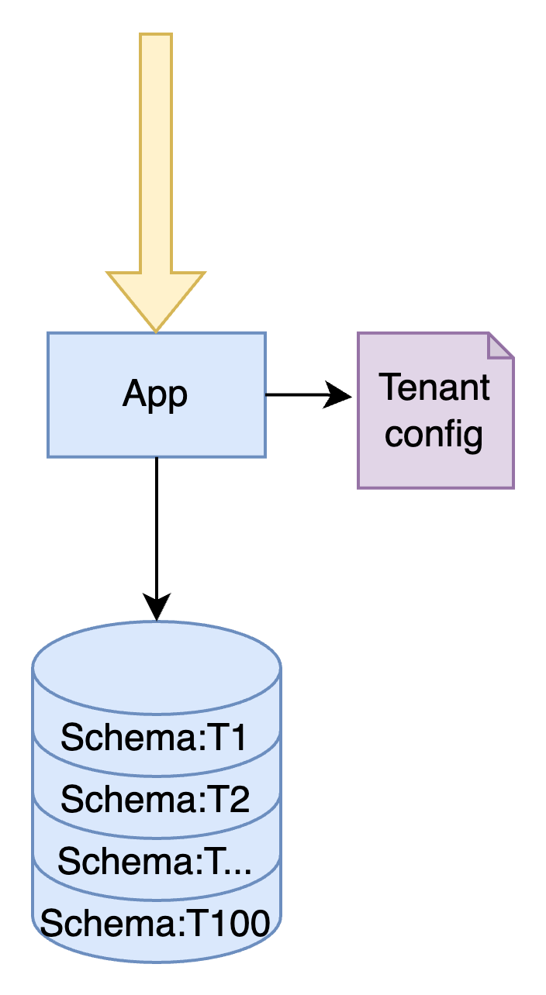

Slide 15
Schema per tenant
✅ Data is mostly separate
✅ Lower operation cost
✅ Cross-tenant reporting is possible
💭 App needs config per tenant
❌ Noisy neighbors

Slide 16
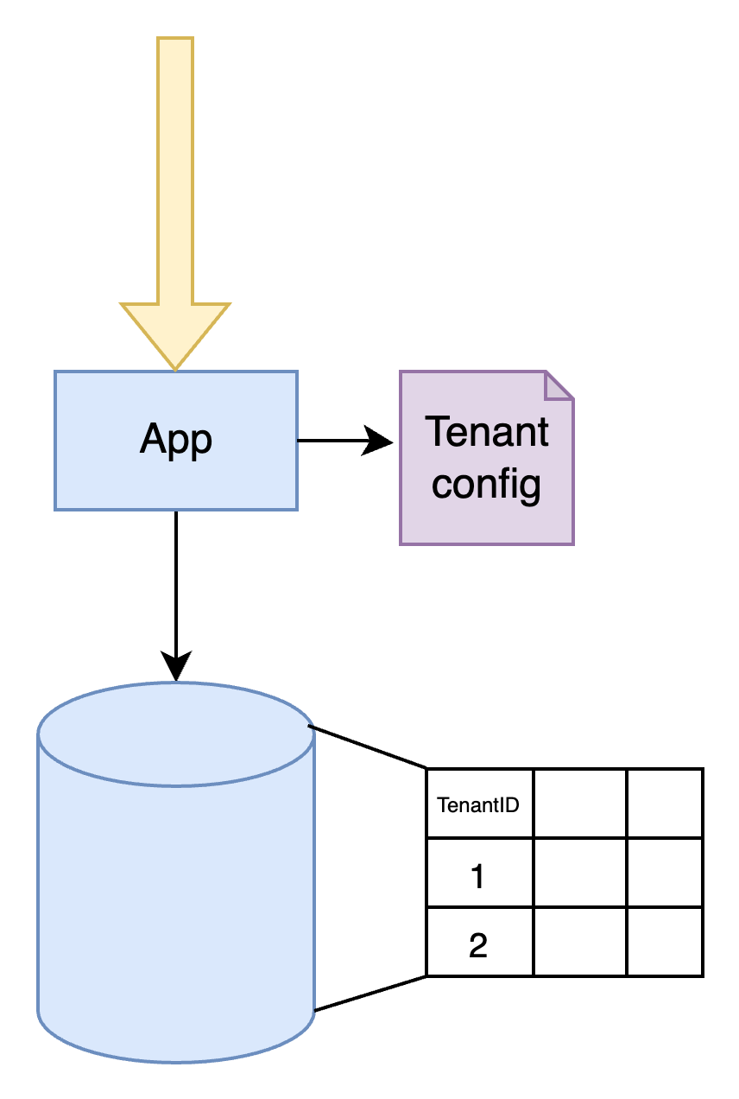

Slide 17
Discriminator column
✅ Lower operation cost
✅ Cross-tenant reporting is possible
✅ Easy to set up
✅ Easy to understand
💭 App needs config per tenant
❌ Noisy neighbors
⚠️ Risk leaky tenant data

Slide 18
Best one?

Slide 19
It depends
🤷

Slide 20
Who’s knocking at the door?
How do you know which tenant to serve

Slide 21
What in what ways could we detect which tenant is calling ?

Slide 22
Query string
https://my-website.com?tenantId=customer1

Slide 23
Header
GET http://my-website.com/page x-TenantId: customer1

Slide 24
Subdomain
http://customer1.my-website.com/page

Slide 25
Enough Talk Show me the code 🧑‍💻
What tenant is calling

Slide 26
Demo time!
Let’s make an application multi-tenant aware!

Slide 27
Script
Detect a tenant
Middleware
Subdomain
TenantContext + Accessor
Reflect a tenant
Knowing available tenants ->
TenantConfig extending with custom info
Protect a tenant
ApplicationUser
ApplicationUserStore
MultiTenantSigninManager
Protect the data
Introduce Itenant
QueryFilter

Slide 28
Detecting a tenant

Slide 29
Detecting a tenant – Tenant.cs
public class Tenant { public string Id { get; set; } }
public class TenantContextAccessor { public Tenant Tenant { get; set; } }

Slide 30
Detecting a tenant - TenantDependencyExtensions
public static class TenantContextAccessorExtensions { public static IServiceCollection AddTenantContext(this IServiceCollection services) { services.AddScoped<TenantContextAccessor>(); services.AddTransient<Tenant>(p => p.GetRequiredService<TenantContextAccessor>().Tenant ?? new Tenant() ); return services; } }

Slide 31
Building Middleware
public class TenantMiddleware(TenantContextAccessor tenantContextAccessor) : IMiddleware
{
public Task InvokeAsync(HttpContext context, RequestDelegate next)
{
var subDomain = context.Request.Host.Host.Split('.')[0];
tenantContextAccessor.Tenant = new()
{
Id = subDomain
};
return next(context);
}
}
builder.Services.AddScoped<TenantMiddleware>();

Slide 32
Reflecting a Tenant

Slide 33
Reflecting a tenant – Tenant.cs
public class Tenant
{
public string Id { get; set; }
public string Name { get; set; }
public string Color { get; set; }
public string CityImage { get; set; }
}

Slide 34
Reflecting a tenant – appsettings.json
"AvailableTenants": {
"Tenants": [
{
"Id": "pallet-town",
"Name": "Pallet Town",
"Color": "#1a8a78",
"CityImage": "https://archives.bulbagarden.net/media/upload/7/77/Pallet_Town_FRLG.png"
},
{
"Id": "vermillion-city",
"Name": "Vermillion City",
"Color": "#d05535",
"CityImage": "https://archives.bulbagarden.net/media/upload/8/8d/Vermilion_City_FRLG.png"
}
]
}
Notes:
#75d9d7
https://archives.bulbagarden.net/media/upload/7/77/Pallet_Town_FRLG.png
#b956ff
https://archives.bulbagarden.net/media/upload/8/8d/Vermilion_City_FRLG.png
{ "Id": "pallet-town", "Name": "Pallet Town", "BackgroundColor": "#75d9d7", "BackgroundImage": "https://archives.bulbagarden.net/media/upload/7/77/Pallet_Town_FRLG.png" }, { "Id": "vermillion-city", "Name": "Vermillion City", "BackgroundColor": "#b956ff ", "BackgroundImage": "https://archives.bulbagarden.net/media/upload/8/8d/Vermilion_City_FRLG.png" }

Slide 35
Reflecting a tenant – program.cs
builder.Services.Configure<AvailableTenants>( builder.Configuration.GetSection(AvailableTenants.SectionName) );
OR
public class AvailableTenantsSetup(IConfiguration configuration) : IConfigureOptions<AvailableTenants> { public void Configure(AvailableTenants options) { configuration.GetSection(AvailableTenants.SectionName).Bind(options); } }

Slide 36
Reflecting a tenant – TenantMiddleware.cs
public Task InvokeAsync(HttpContext context, RequestDelegate next)
{
var subDomain = context.Request.Host.Host.Split('.')[0];
var tenant = availableTenants.Value.Tenants.FirstOrDefault(t => t.Id == subDomain);
if(tenant == null)
{
context.Response.StatusCode = (int)HttpStatusCode.NotFound;
return Task.CompletedTask;
}
tenantContextAccessor.Tenant = tenant;
return next(context);
}

Slide 37
Reflecting a tenant – _Layout.cshtml
<style>
:root {
--tenant-color: @tenant.Color;
--tenant-city-image: url('@tenant.CityImage');
}
</style>

Slide 38
Reflecting a tenant – Index.cshtml
@inject Tenant tenant;
<div class="gb-city-frame">
<img src="@tenant.CityImage" />
</div>
<div class="gb-title-block">
<div class="gb-title-main">POKECENTER</div>
<div class="gb-title-sub">@tenant.Name</div>
</div>

Slide 39
Protecting a Tenant

Slide 40
Protecting a tenant – ApplicationUser.cs
public class ApplicationUser : IdentityUser { public string TenantId { get; set; } }

Slide 41
Protecting a tenant – ApplicationDbContext.cs
public class ApplicationDbContext( DbContextOptions<ApplicationDbContext> options) : IdentityDbContext<ApplicationUser>(options) { //… }

Slide 42
Protecting a tenant – Add Migration
dotnet ef migrations add applicationuser -s ../PokeCenter.web

Slide 43
Protecting a tenant – ApplicationUserStore
public class ApplicationUserStore( ApplicationDbContext context, Tenant tenant, IdentityErrorDescriber? describer = null) : UserStore<ApplicationUser>(context, describer) { public override Task<IdentityResult> CreateAsync(ApplicationUser user, CancellationToken cancellationToken = new CancellationToken()) { user.TenantId = tenant.Id; return base.CreateAsync(user, cancellationToken); } }

Slide 44
Protecting a tenant – MultiTenantSigninManager
public class MultiTenantSigninManager( /**/, Tenant tenant ) : SignInManager<ApplicationUser>(/**/) { public override Task<SignInResult> PasswordSignInAsync(ApplicationUser user, string password, bool isPersistent, bool lockoutOnFailure) { if (user.TenantId != tenant.Id) return Task.FromResult(SignInResult.Failed); return base.PasswordSignInAsync(user, password, isPersistent, lockoutOnFailure); } };

Slide 45
Protecting a tenant – Program.cs
builder.Services .AddDefaultIdentity<ApplicationUser>(options => options.SignIn.RequireConfirmedAccount = true) .AddEntityFrameworkStores<ApplicationDbContext>() .AddUserStore<ApplicationUserStore>() .AddSignInManager<MultiTenantSigninManager>() ;

Slide 46
Protecting a tenant – LoginPartial.cshtml
@* @inject SignInManager<ApplicationUser> SignInManager *@ @inject MultiTenantSigninManager SignInManager @inject UserManager<ApplicationUser> UserManager

Slide 47
Protecting the data
(of a tenant)

Slide 48
Protecting the data – Itenanted.cs
public interface ITenanted { public string TenantId { get; set; } }

Slide 49
Protecting the data – HealingPod.cs
public class HealingPod : ITenanted { public int Id { get; set; } public int MaxCapacity { get; set; } public List<PokemonAdmission> Admission { get; set; } public string TenantId { get; set; } }

Slide 50
Protecting the data – PokemonAdmission
public class PokemonAdmission : ITenanted { public int Id { get; set; } //…
public string TenantId { get; set; } }

Slide 51
Protecting the data – TenantIdValueGenerator
public class TenantIdValueGenerator : ValueGenerator<string> { public override string Next(EntityEntry entry) { if (entry.Entity is ITenanted && entry.Context is ApplicationDbContext applicationDbContext) { return applicationDbContext.Tenant; } throw new InvalidOperationException("TenantId is expected to be set on this entity!"); } public override bool GeneratesTemporaryValues { get; } = false; }

Slide 52
Protecting the data – ApplicationDbContext
builder.Entity<HealingPod>(entity =>
{
entity.HasKey(e => new { e.Id });
entity
.Property(e => e.TenantId)
.IsRequired()
.HasValueGenerator<TenantIdValueGenerator>();
entity.HasIndex(e => e.TenantId);
entity.HasQueryFilter(e => e.TenantId == TenantId);
});

Slide 53
Protecting the data – ApplicationDbContext
builder.Entity<PokemonAdmission>(entity =>
{
entity.HasKey(e => new { e.Id });
entity
.Property(e => e.TenantId)
.IsRequired()
.HasValueGenerator<TenantIdValueGenerator>();
entity.HasIndex(e => e.TenantId);
entity.HasQueryFilter(e => e.TenantId == TenantId);
});

Slide 54
Keeping it DRY
(with magic 🪄)

Slide 55
Keeping it DRY (with magic 🪄)
protected override void OnModelCreating(ModelBuilder builder)
{
var tenantedModels = builder.Model.GetEntityTypes().Where(e =>
typeof(ITenanted).IsAssignableFrom(e.GetType())
);
foreach(var model in tenantedModels)
{
builder.Entity(model.ClrType)
.HasQueryFilter((ITenanted e) => e.TenantId == Tenant.Id)
.HasIndex(nameof(ITenanted.TenantId))
;
builder.Entity(model.ClrType)
.Property(nameof(ITenanted.TenantId))
.IsRequired()
.HasValueGenerator<TenantIdValueGenerator>();
}
}

Slide 56
Shameless self promotion
For charity and profit!

Slide 57


Slide 58


Slide 59
Where to find stuff
Code on github
https://github.com/RubMertens/presentation-multi-tenant-apps

